Slide 1
Predicting Poverty Rates by Census Block
Jehan Bugli

Slide 2
POVERTY IN THE UNITED states HAS CONSISTENTLY EXCEEDED 10%
Notes:
“Table A-3”, Census, accessed December 11, 2024, https://www.census.gov/library/publications/2024/demo/p60-283.html#:~:text=Official%20Poverty%20Measure%3A,and%20Table%20A-1).

Slide 3





DATASET: AMERICAN COMMUNITY SURVEY (ACS)
The ACS is conducted annually, tracking a large number of data points across the US population; more granular data is provided as a 5-year average, which is what I used (2017-2022)
After determining the fields I wanted, I build out a separate Python script to retrieve data from the API
Benefits of using the ACS:
ACS tracking is more granular than most other sources
The ACS tracks many different potential factors
ACS data is readily available through a Census API service

Slide 4







I SELECTED A LARGE NUMBER OF INPUTS TO LOAD AND INVESTIGATE
Including …
Total population
Age
Race and ethnicity
Method of transportation
Educational attainment
Available housing units
Veteran status
And more

Slide 5

I ALTERED THE RAW DATA TO IMPROVE MODELING SUITABILITY
I discarded Census blocks with populations below 500
I imputed the median year in which structures were built (using the state + county)
I dropped identifiers
I converted housing units into individuals per housing unit
I consolidated longer commute time fields
I consolidated gender-based age brackets
I converted raw counts into population percentages in bulk
This includes the percentage of individuals below the poverty line
Post-split input data was scaled using the standard scaler
While I extensively tested one-hot encoding to represent state location, the approach ultimately didn’t lead to appreciable improvements

Slide 6

MY SELECTED TARGET WAS A BINARY CLASSIFICATION OF POVERTY INCIDENCE
The distribution of poverty is heavily skewed; while I could have attempted regression or more granular classification methods, I felt that the most robust and actionable method was a simple binary classification indicating whether or not the Census block contains individuals below the poverty threshold.

Slide 7
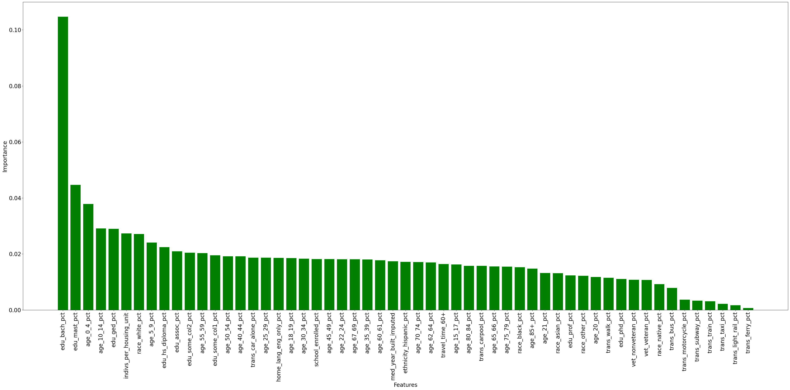

AFTER EXPLORING FEATURE IMPORTANCE through a decision tree, most inputs displayed consistent impacts
Apart from a few standouts on either end, feature importance was relatively consistent across the set of chosen inputs in an exploratory decision tree

Slide 8




MY FIRST APPROACH WAS A GRID SEARCH ACROSS 4 promising candidate models
Including …
My target metric was precision, aligning with certain limitations/decisions made in light of future attempts
Decision Tree Classifier
Random Forest Classifier
Multi-Layer Perceptron Classifier
HistGradient Boosting Classifier

Slide 9
The random forest approach pulled ahead after tuning with cross-validation grid search results
Notes:
“Table A-3”, Census, accessed December 11, 2024, https://www.census.gov/library/publications/2024/demo/p60-283.html#:~:text=Official%20Poverty%20Measure%3A,and%20Table%20A-1).

Slide 10
COMBINING MODELS INTO A VOTING CLASSIFIER ULTIMATELY DEGRADED RESULT QUALITY RELATIVE TO THE INDIVIDUAL MODELS
Notes:
“Table A-3”, Census, accessed December 11, 2024, https://www.census.gov/library/publications/2024/demo/p60-283.html#:~:text=Official%20Poverty%20Measure%3A,and%20Table%20A-1).

Slide 11
MY FINAL ATTEMPT FEATURED A SEQUENTIAL NEURAL NETWORK WITH DROPOUT
I hypothesized that the MLPC performance limitations could be improved upon with a more complex model (using dropout to prevent overfitting)
After facing limitations with f1 macro scoring implementation initially, I switched my target – and interpretation – to precision
The optimized model had 2 50-perceptron hidden layers with elu activation functions; before the output layer, I introduced a 6% dropout rate

Slide 12
The NEW MODEL SAW VERY MODEST GAINS RELATIVE TO THE ORIGINAL multi-layer perceptron CLASSIFIER
Notes:
“Table A-3”, Census, accessed December 11, 2024, https://www.census.gov/library/publications/2024/demo/p60-283.html#:~:text=Official%20Poverty%20Measure%3A,and%20Table%20A-1).

Slide 13




CONCLUSION: the chosen factors are impactful, but the model requires extension for better real-world impacts
My best model, the Random Forest Classifier, had a precision of ~84%, which appears to be a reasonably strong indicator of my inputs’ impacts
I overestimated gains in predictive power from model complexity, including a voting ensemble and neural network architectures
Potential next steps …
Geography additions
Other data sources
Model architectures
Reframing the problem

